Slide 1
Software-Defined Radio (SDR)
PART TWO
Robert Schafer W5IUA
July, 2024

Slide 2
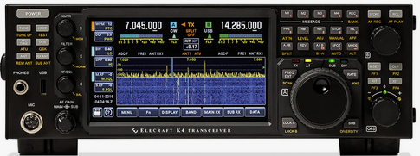
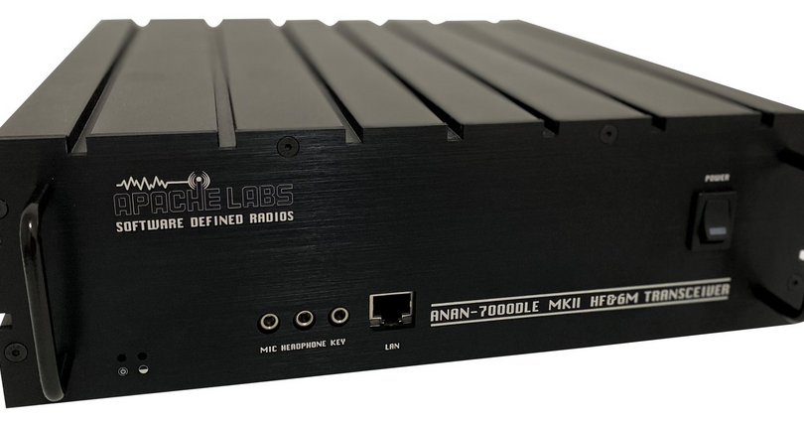
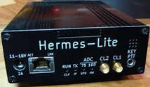
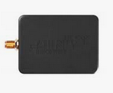
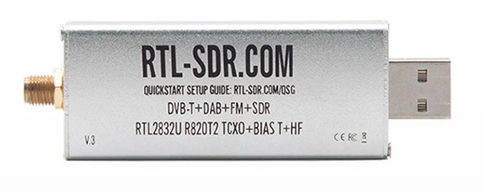
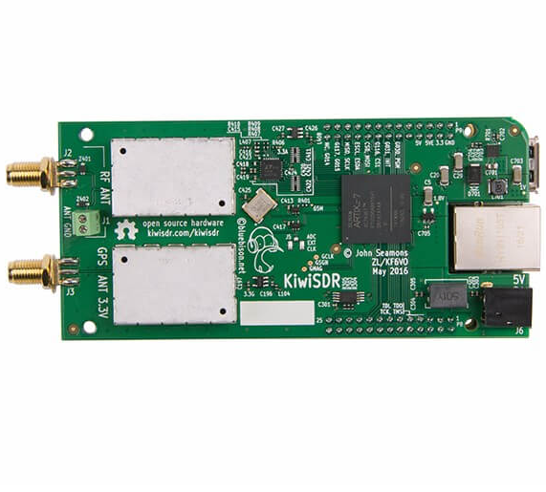
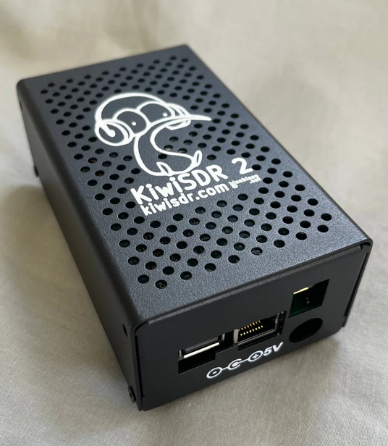
SDRs in Amateur Radio
Transceiver Examples
Integrated (no PC required) Elecraft, Icom, Yaesu
Component Apache Labs, FlexRadio, Hermes Lite 2, SunSDR
Receiver Examples
Component Airspy, SDRPlay, RTL-SDR Dongles
Online SDR - Networks
Airspy.com (40 sites)
Global Tuners (28 sites)
WebSDRs (141 sites)
OpenWebRX (244 sites)
KiwiSDRs (914 sites)

Slide 3
Online SDRs…
are receivers connected to the internet, allowing many listeners to listen and tune in simultaneously. SDR technology makes it possible that all listeners tune independently, and thus listen to different frequencies and signals.
Typically consists of a PC server and SDR server software, a fast internet connection, and radio hardware to feed antenna signals into the PC.
Amateurs appreciate and benefit greatly from a global network of online SDRs made possible thanks to time, effort, and expense others make to install and maintain equipment and connectivity. Access to nearly every online SDR is made available to all without cost or subscriptions.

Slide 4
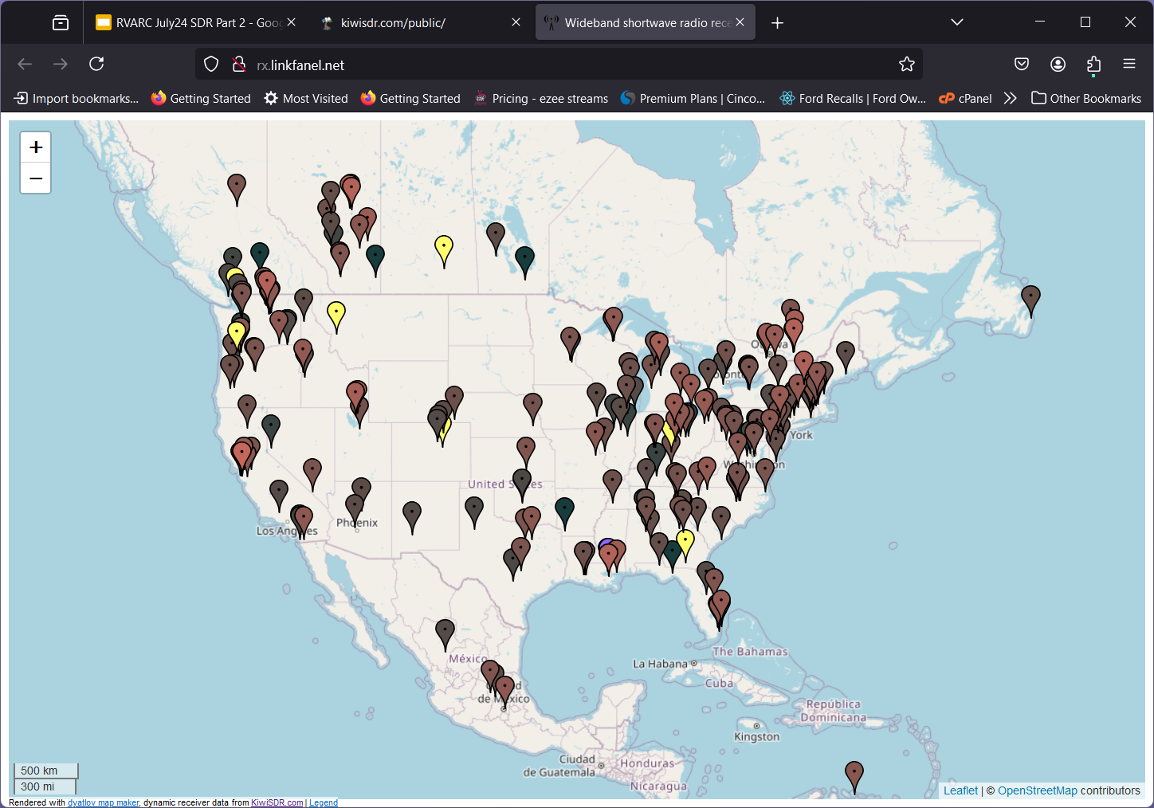
KiwiSDR Map -North America

Slide 5
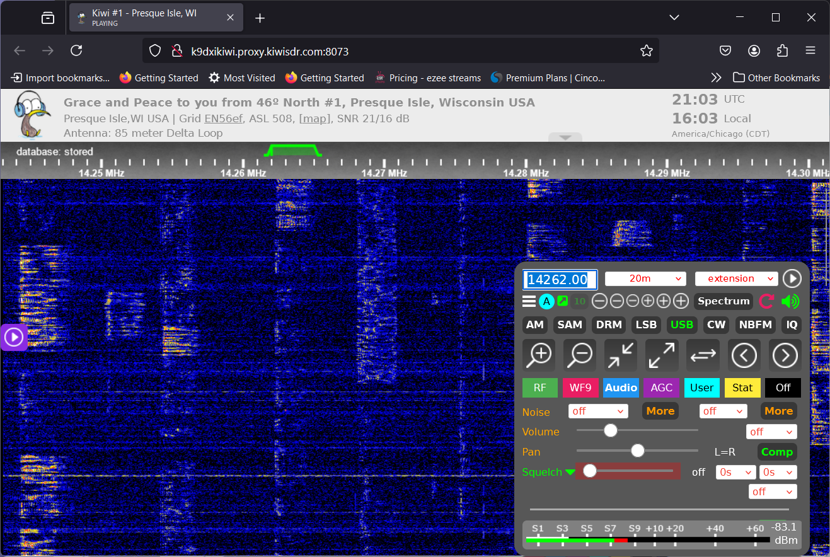
Web Browser Access - one SDR

Slide 6
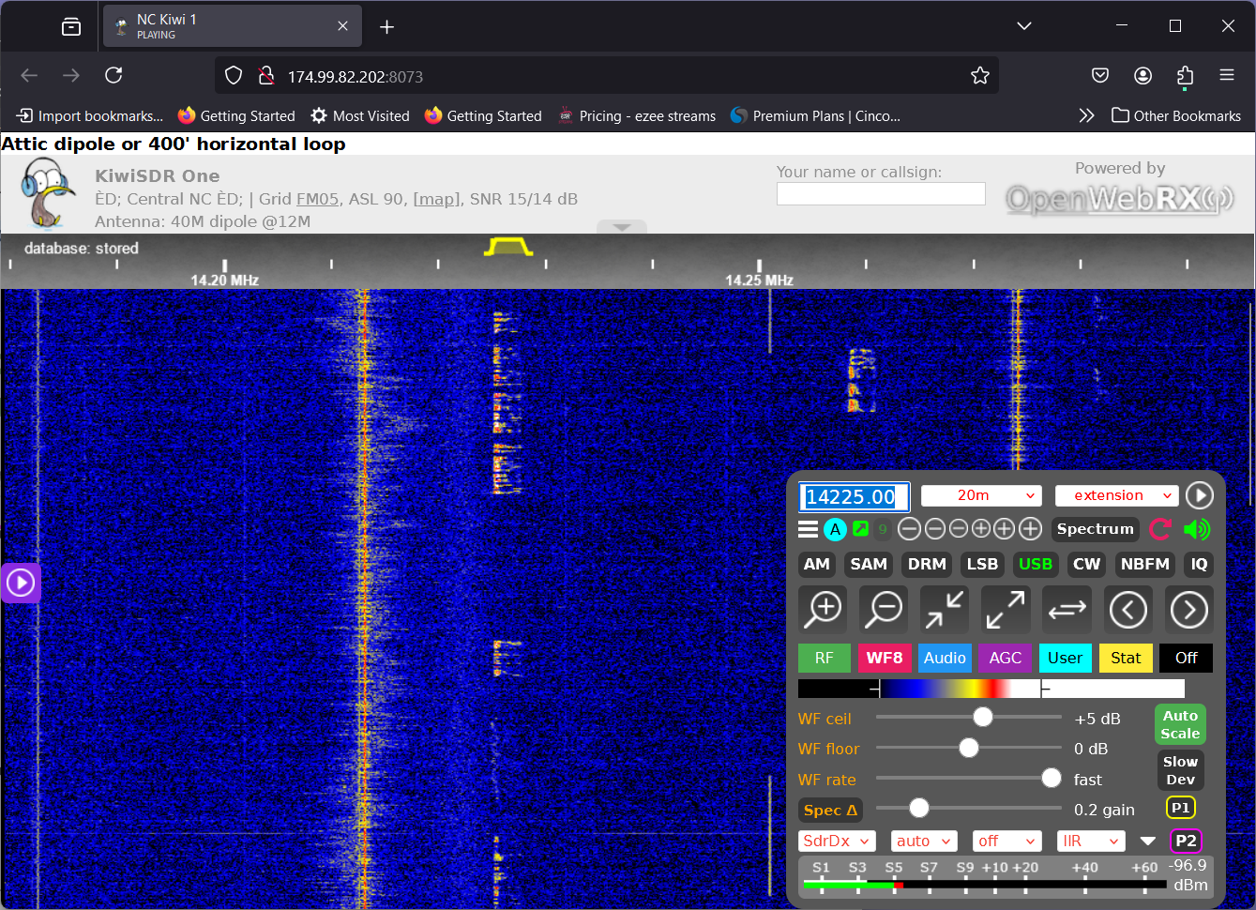
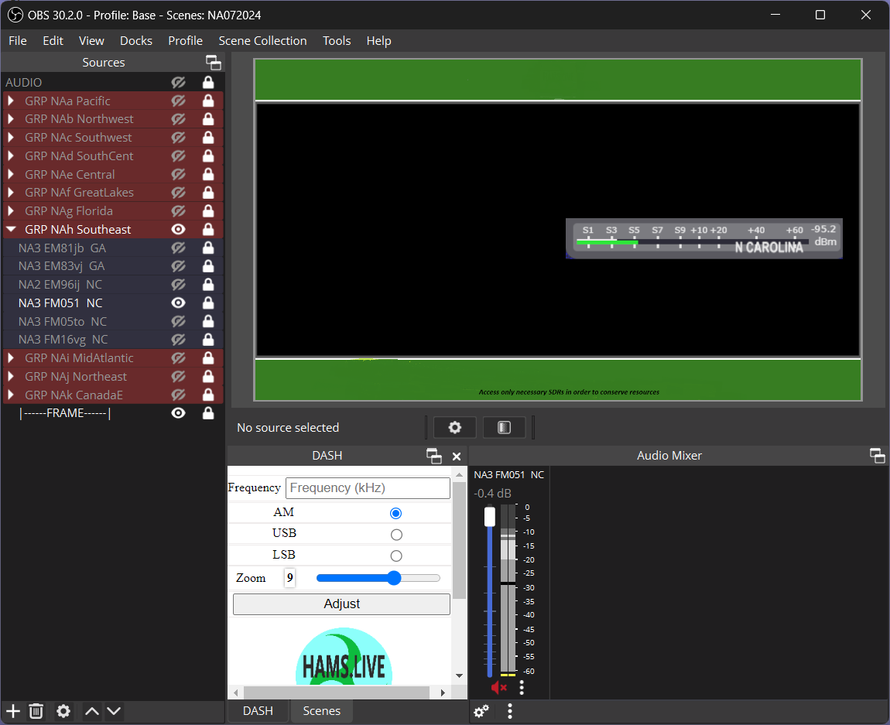
SDR Access Comparison Browser versus hams.live
Web Browser
on User’s PC
KIWISDR North Carolina
PUBLIC URL
http://174.99.82.202:8073/
Internet
OBS Studio
on User’s PC
U S E R S
PUBLIC URL
http://174.99.82.202:8073/ PLUS FREQ/MODE & PARAMETERS
SYSTEM URL
http://hams.live/k/fmb/ PLUS FREQ/MODE & PARAMETERS
WEB SERVER

Slide 7
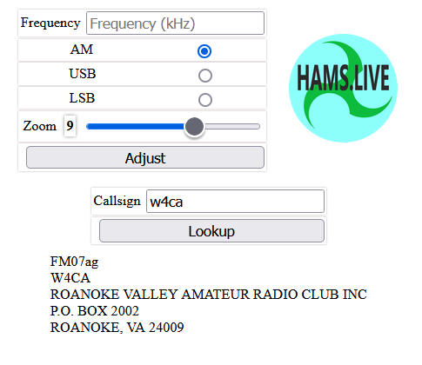
hams.live DASHboard

Slide 8
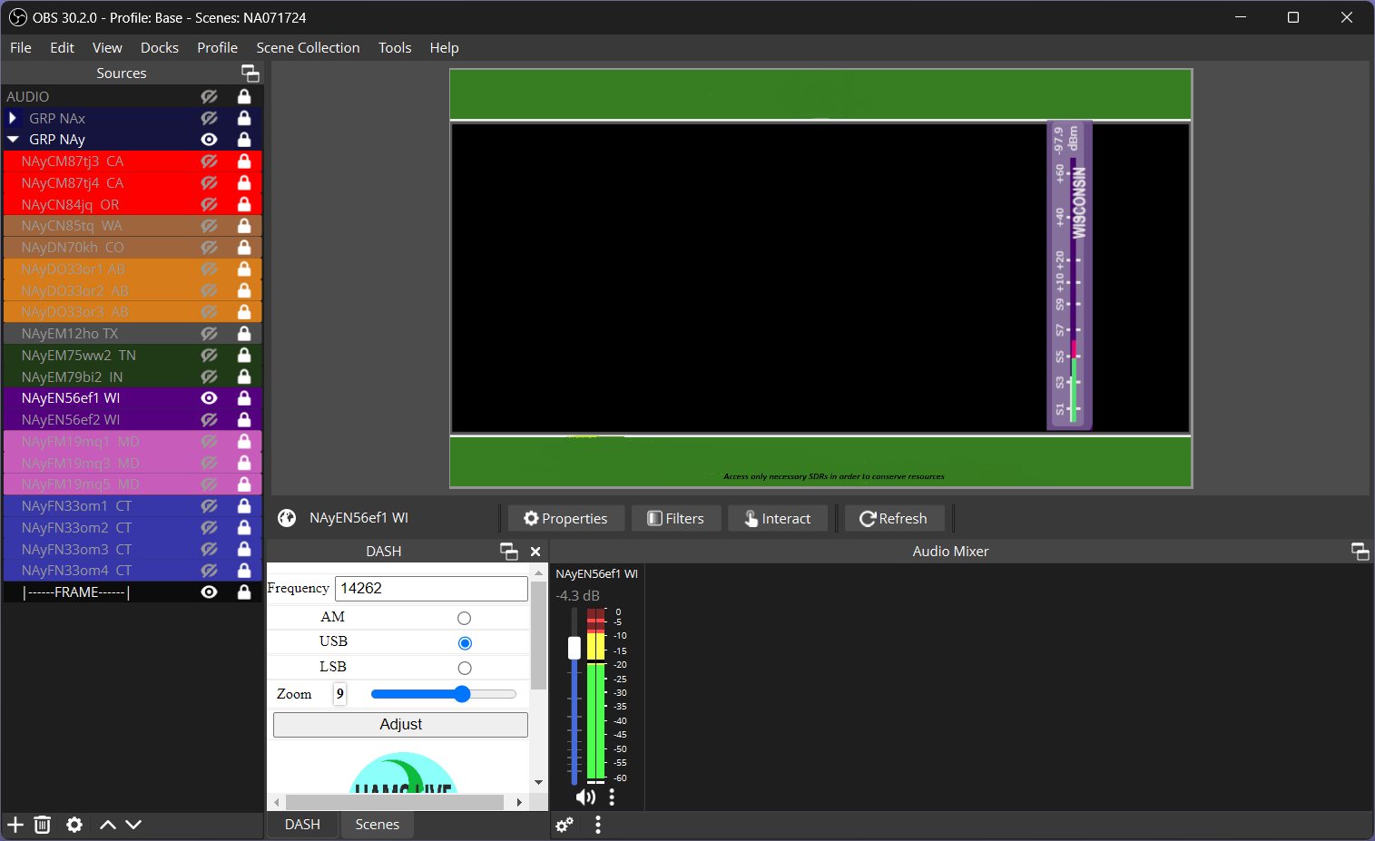
hams.live/OBS Access - one SDR

Slide 9
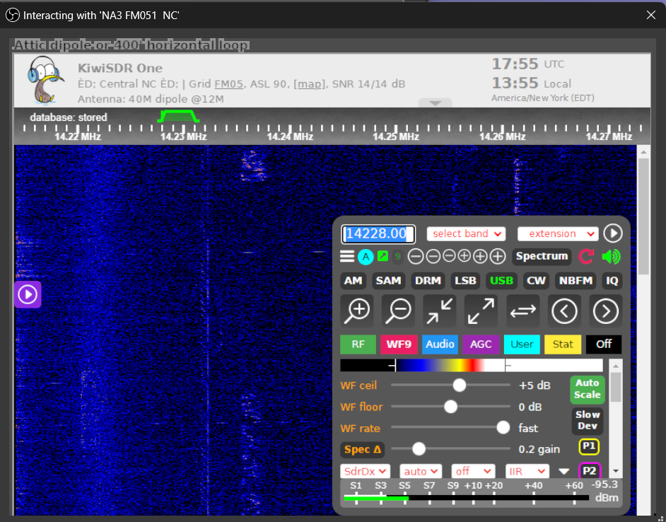
OBS Browser Source - S Meter Capture

Slide 10
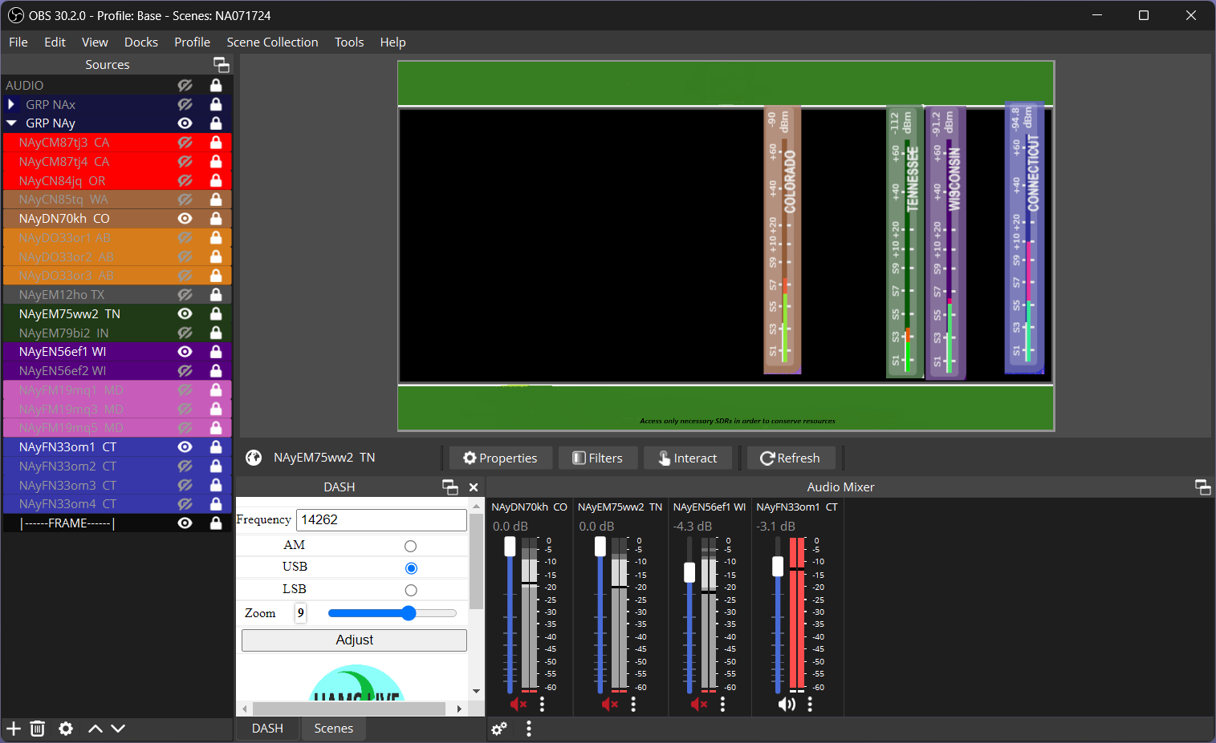
hams.live/OBS Access - four SDRs

Slide 11
Installation Steps: hams.live/inst/
Download and install OBS Studio
Download and install OBS Websockets plugin
Configure hams.live DASHboard in OBS
Download hams.live image files on your PC
Download hams.live Scene Collection/import into OBS

Slide 12
hams.live demonstration
INSTALLATION http://hams.live/inst/ admin@hams.live

