Slide 1
Software-Defined Radio (SDR)
PART ONE
Robert Schafer W5IUA
May, 2024

Slide 2
Part One Agenda
SDR Definition
What is SDR?
SDRs in Amateur Radio
Component SDR Software Examples
Online SDRs…
Why use an Online SDR?
OpenWebRX
WebSDR
KiwiSDR
KiwiSDR Settings Demo

Slide 3
SDR Definition
Software-Defined Radio (SDR) is a radio communication system where components that conventionally have been implemented in analog hardware (e.g. mixers, filters, amplifiers, modulators/demodulators, detectors) are instead implemented by means of software on a computer or embedded system.
-Wikipedia

Slide 4
What is SDR?
Components traditionally implemented with analog are instead done by software on a dedicated or standard piece of computer hardware (e.g., PC)
Made possible by faster and faster microchips that allow signals to be captured in analog and then converted the digital domain (1s and 0s)
Digital Signal Processing (DSP) is done in the digital domain which consists of the filtering and demodulation of the desired signal

Slide 5
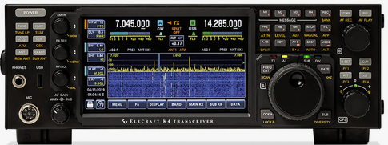
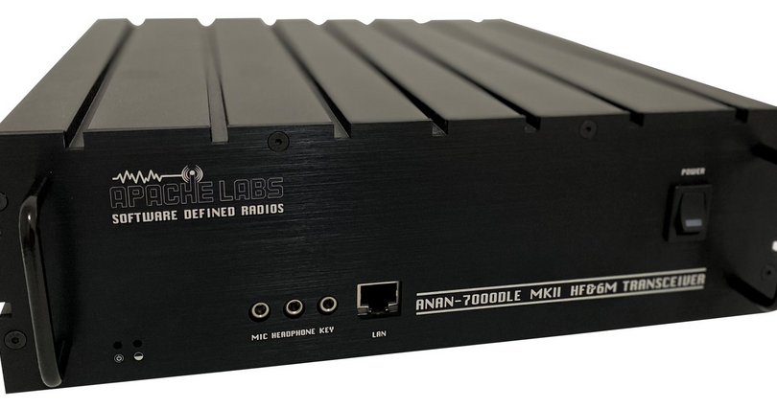
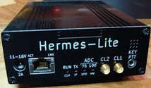
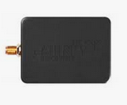
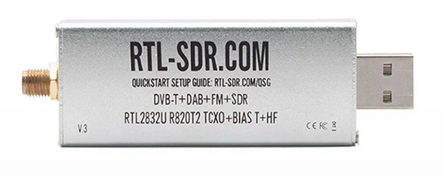
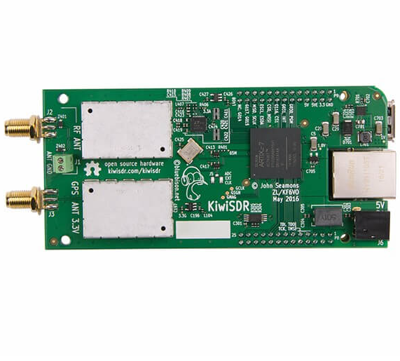
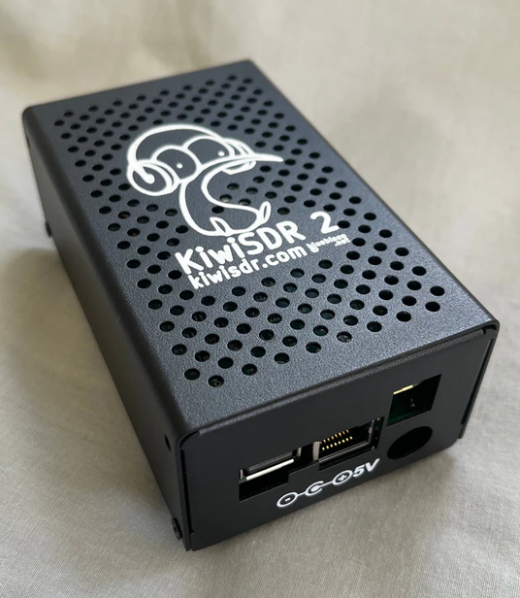
SDRs in Amateur Radio
Transceiver Examples
Integrated (no PC required) Elecraft, Icom, Yaesu
Component Apache Labs, FlexRadio, Hermes Lite 2, SunSDR
Receiver Examples
Component Airspy, SDRPlay, RTL-SDR Dongles
Online SDR - Networks
Airspy.com (40 sites)
Global Tuners (28 sites)
WebSDRs (141 sites)
OpenWebRX (244 sites)
KiwiSDRs (914 sites)

Slide 6
User SDR Software (Component)
SDR# (SDR-Sharp) from Airspy: 3rd party plug-ins - Windows
SDR Console: supports multiple hardware
SDR++: - Windows, Linux, OSX, BSD, Android
SDRUno: best with SDRPlay hardware - Windows
PowerSDR: supports FlexRadio - Windows
HPSDR/Thetis: supports ANAN/Hermes Lite - Windows, Linux
HDSDR: Windows

Slide 7
Online SDRs…
are receivers connected to the internet, allowing many listeners to listen and tune in simultaneously. SDR technology makes it possible that all listeners tune independently, and thus listen to different frequencies and signals. Depending on type of Online SDR, four, eight, or up to a hundred (WebSDR) listeners can use the same site simultaneously.
typically consist of a PC server and SDR server software, a fast internet connection, and some radio hardware to feed antenna signals into the PC.
many times are deployed by radio amateurs. We appreciate and benefit greatly from a global network of Online SDRs made possible thanks to time, effort, and expense others make to install and maintain equipment and connectivity. Access to nearly every Online SDR is made available to all without cost or subscriptions.

Slide 8
Why use an online SDR?
Listening to hear other signals better
Shortwave listening
Commercial broadcasting
Amateur radio
Overcome bad propagation/receiver location diversity
Facilitate net/roundtable sessions to hear everyone
Solution for local antenna restrictions or RFI
Assess HF propagation conditions
Listening to hear your own signal better
A/B testing of antennas, audio, other settings
Real time antenna pattern mapping

Slide 9
Online SDR Use Case
17 Meter Propagation Group more info at http://hams.live/prop17/
Informal round table group that meets daily near 18.162 MHz
Group led by control operator who directs round table communications and manages list of check-in stations
Many in the Group access Online SDRs to improve the ability
to hear stations that otherwise cannot be directly copied A livestreamed list is also maintained to help keep track of check-ins, sequence, and signal reports
Online SDRs help eliminate listening to dead air and instead
hear stations that cannot be copied directly

Slide 10
Online SDRs are different
Like all other radio stations, Online SDRs vary widely in terms of quality and performance. Local site limits what kind of antenna system(s) are chosen. Everything from a simple small loop antenna in the attic to elaborate antenna arrays on tall towers with the ability to switch between different antennas.
The local site also determines what noise levels are encountered.

Slide 11
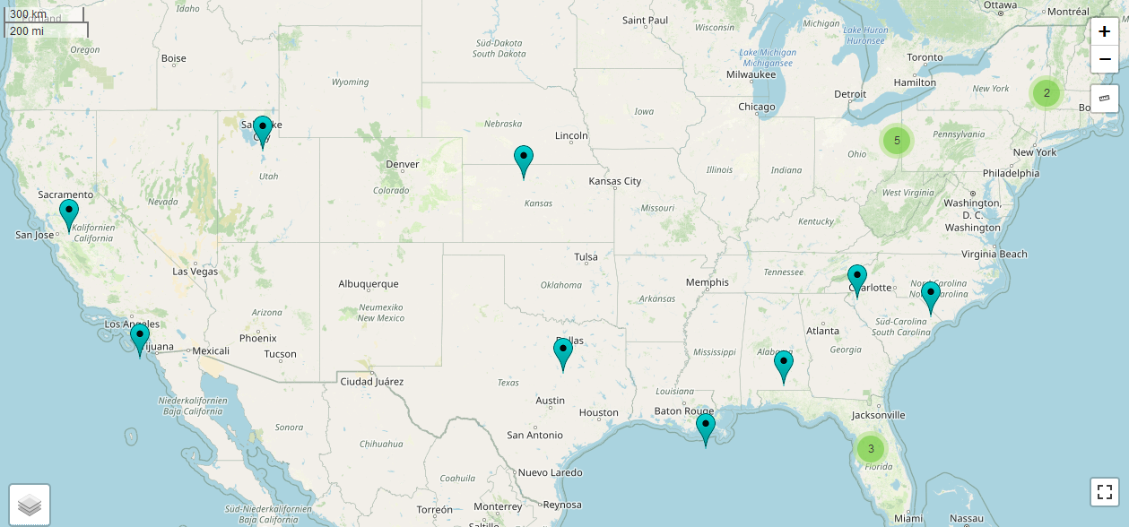
OpenWebRX
PROs
Works with inexpensive RTL-SDR or SDRPlay hardware
Sites support up to 15-20 users
CONs
Much fewer sites available versus KiwiSDR, only 19 US sites supporting HF No longer in development

Slide 12
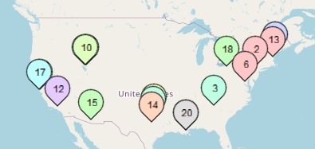
WebSDR
PROs
Sites support up to 100 users at once
CONs
Much fewer sites available versus KiwiSDR, only 25 US Sites with HF
Only works on certain amateur bands - site specific

Slide 13
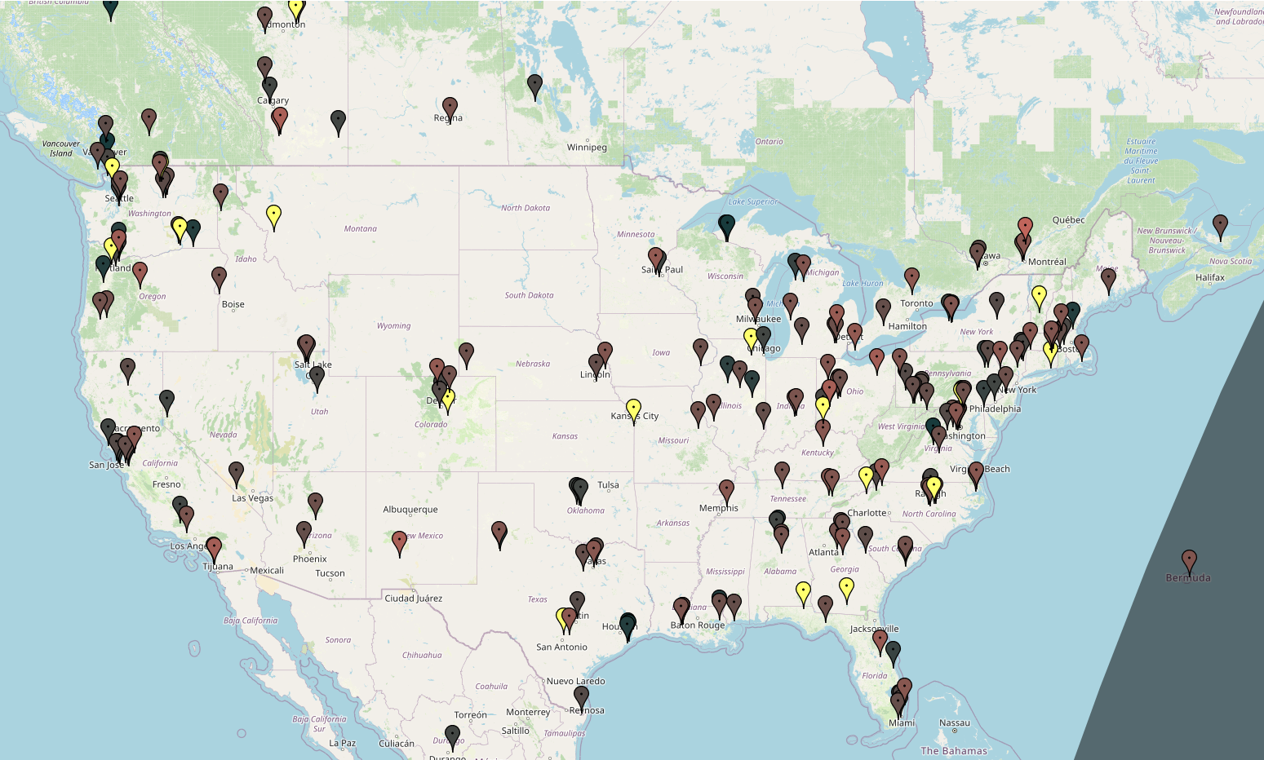
KiwiSDR
PROs
Best selection of sites, 221 US, Over 900 worldwide Sites provide full HF coverage 1-30MHz Wide selection of built-in extensions
Spectral Noise Filtering Camp-on feature/share audio stream
CONs
Sites only support 4 users, or
8 users with limited functionality

Slide 14
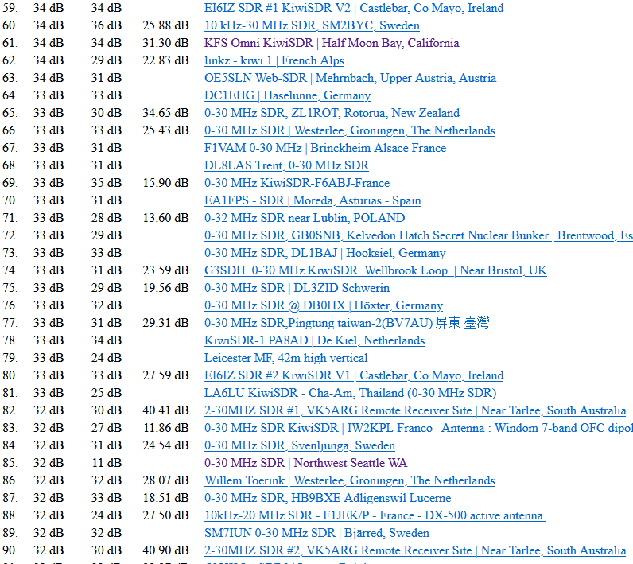
KiwiSDR SNR
KiwiSDRs are ranked
based on Signal to Noise Ratio (SNR).
Currently, best one in North America ranks at #61, located in Half Moon Bay, California.
All results found at: rx.linkfanel.net/snr.html

Slide 15
KiwiSDR URL Parameters
Pennsylvania SDR 40 Meters
http://kiwisdr.k3fef.com:8073/?f=7168lsbz10&keys=xyxySo&sqrt=4&wfm=-100&cmap=5
FREQUENCY/MODE
WATERFALL ZOOM
DISPLAY OPTIONS
WATERFALL CONTRAST
WATERFALL SIZING
WATERFALL COLORMAP
LIST OF KIWISDR URL PARAMETERS AT: http://kiwisdr.com/quickstart/#id-user-tune

Slide 16
KiwiSDR Settings Demo
Pennsylvania SDR 40 Meters
Utah SDR 40 Meters
Half Moon Bay, CA 40 Meters
Lamont, Alberta, 40 Meters

Slide 17
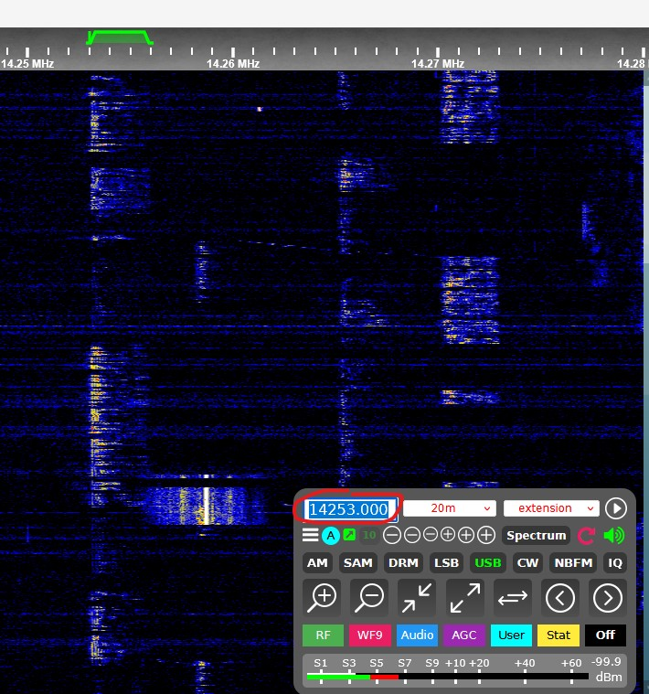
KiwiSDR Settings Demo
Direct frequency input

Slide 18
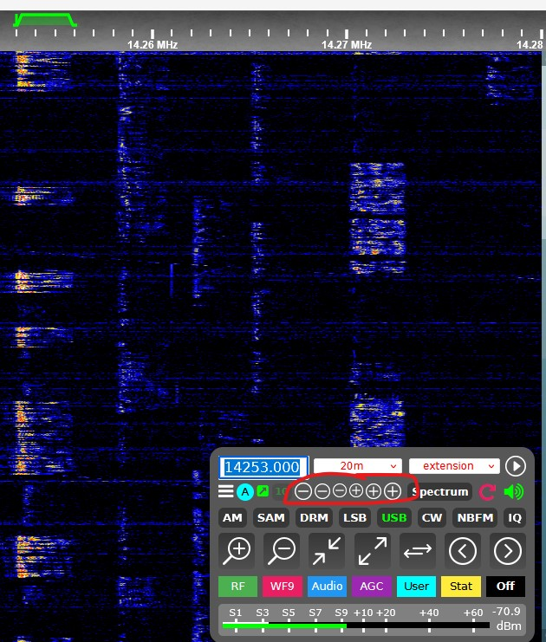
KiwiSDR Settings Demo
Frequency input in steps

Slide 19
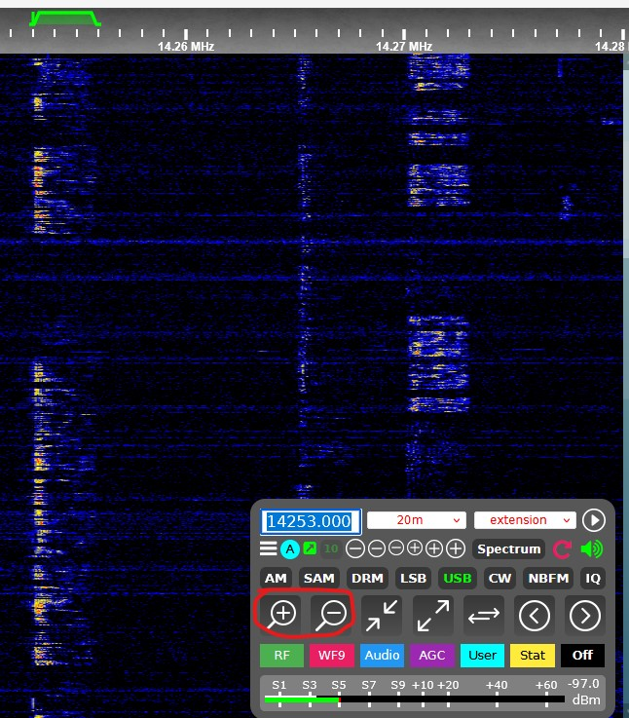
KiwiSDR Settings Demo
Zoom level in or out

Slide 20
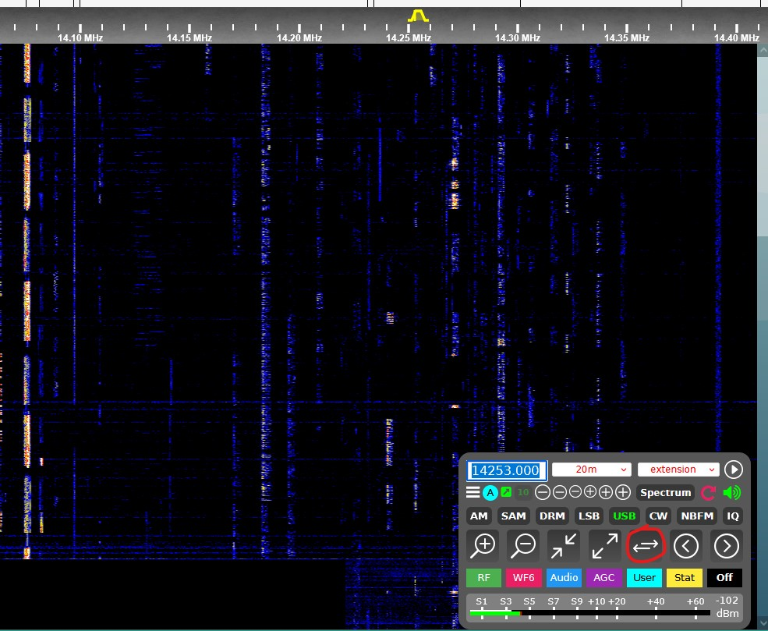
KiwiSDR Settings Demo
Zoom out band level

Slide 21
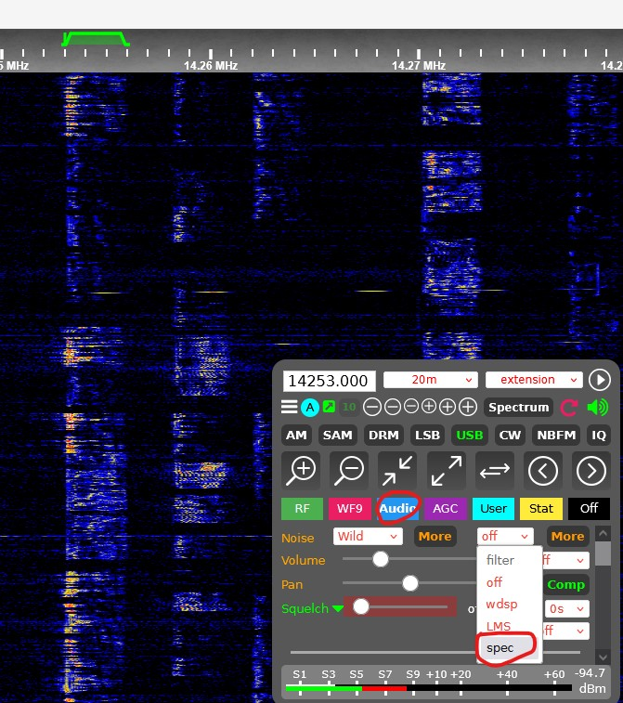
KiwiSDR Settings Demo
SELECT AUDIO TAB
Spectral Filter

Slide 22
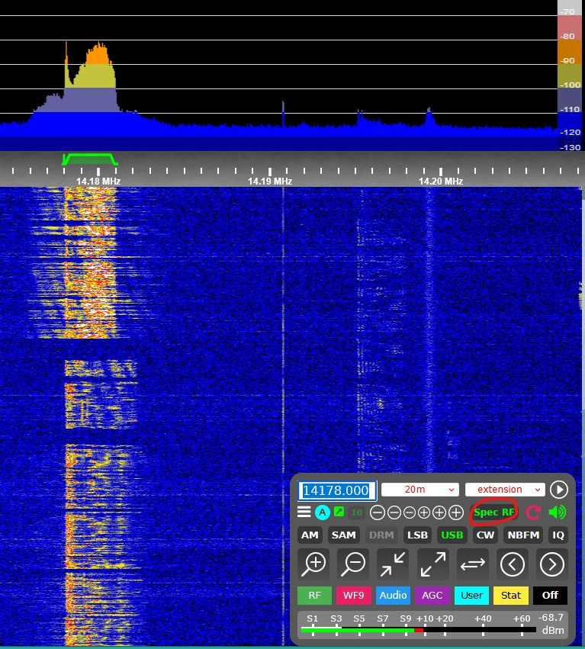
KiwiSDR Settings Demo
RF Spectrum
Spectrum mode - RF

Slide 23
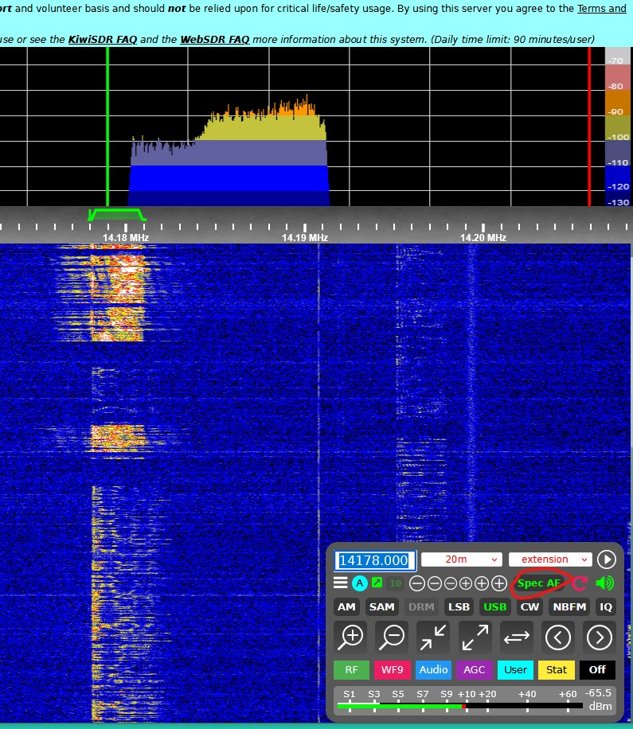
KiwiSDR Settings Demo
AF Spectrum
Spectrum mode - AF

Slide 24
RVARC in July….PART 2
A system to manage using Online SDRs
Today’s presentation can be viewed at http://hams.live/sdr/

